Slide 1

AZBanking
Home of convenient banking.

Slide 2
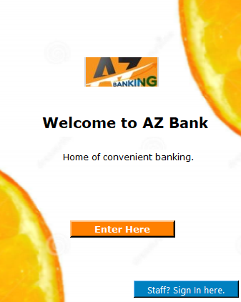
Home Page
This page comes up when the app is launched, it allows both customers and staffs of the bank to use the features within.

Slide 3
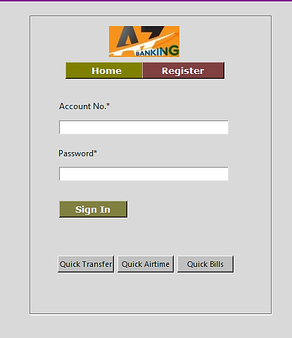
Sign In Page
The customers can sign in using their account number and the password created when registering.
It has access to Quick transfer, Quick Airtime and Quick Bills.

Slide 4
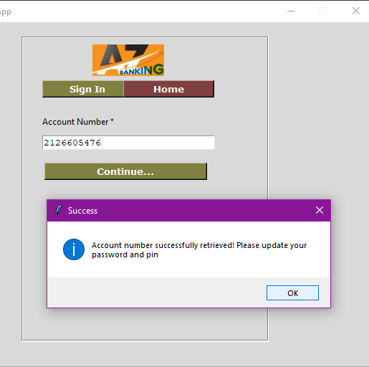
Check if Account Exists
This is the register section where the customer will enter his/her account number and proceed to the next page.

Slide 5
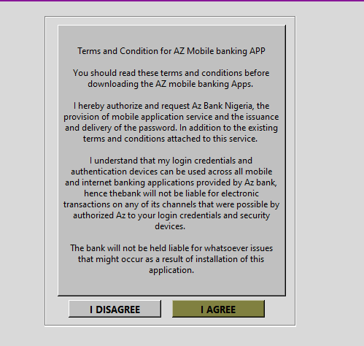
Disclaimer Frame
The customer can either decide to agree or disagree with the terms and conditions of the bank.

Slide 6
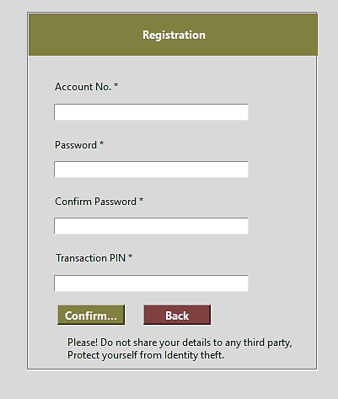
Registration Page
The customer can input their account numbers, password and pin which will be used for transactional processes.

Slide 7
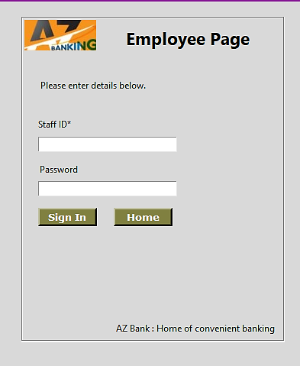
Employee Frame
This is a page where the employee of the bank can login with their username and password and perform their daily transactions.

Slide 8
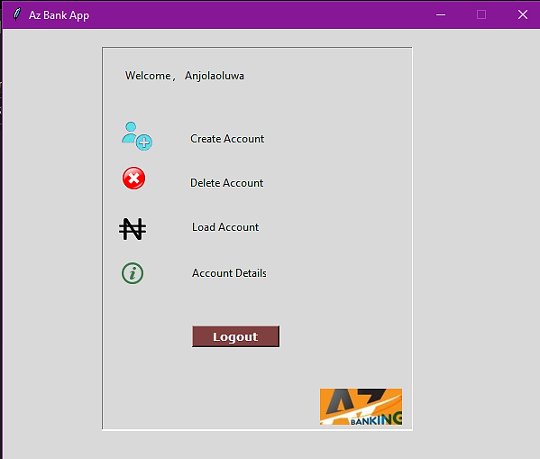
Employee Dashboard
This is the employee dash board, the staffs of the bank can perform their daily tasks as seen below.
Create Account
Delete Account
Load Account
View account details

Slide 9
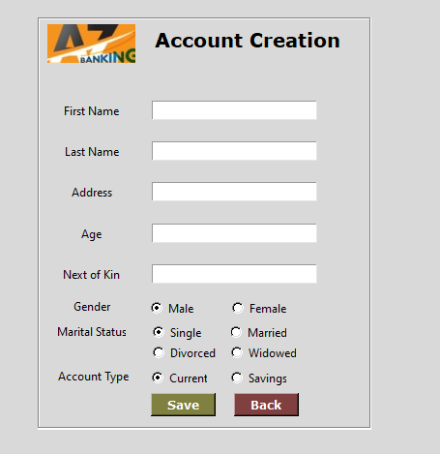
Account Creation Frame
The account creation section is for setting up a customer’s account, with the inputs below:
First Name
Last Name
Address
Age
Next of Kin
Gender
Marital status

Slide 10
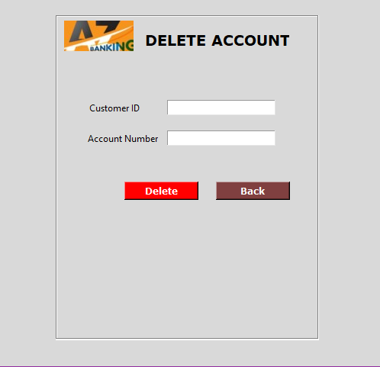
Account Deletion Frame
This is where account numbers can be deleted from the bank’s database.

Slide 11
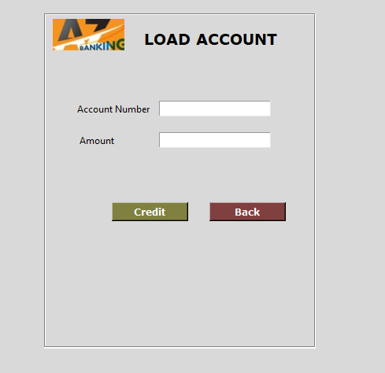
Account Loading Frame
This is a page where a customer’s account can be credited with any amounts.

Slide 12
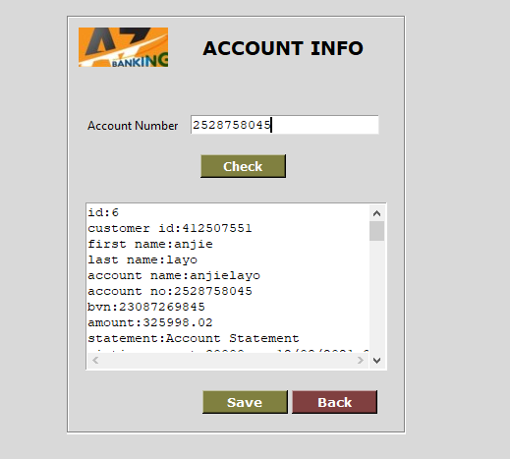
Account Information Frame
This is a page that allows a customer’s account details to be viewed on the system.

Slide 13
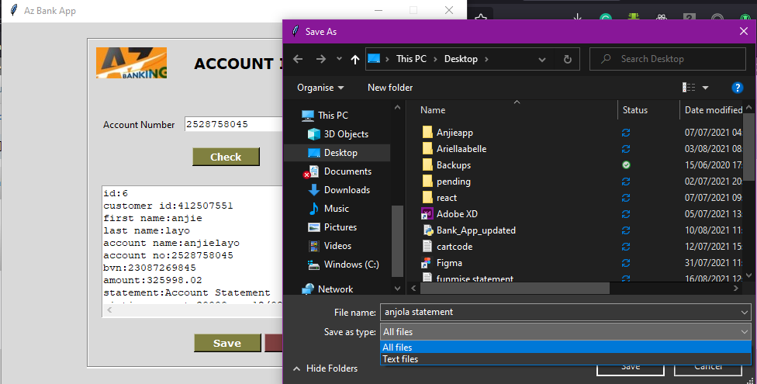
How the Account Statement Can Be Saved
A customer’s account details can be downloaded and saved to the desktop.

Slide 14
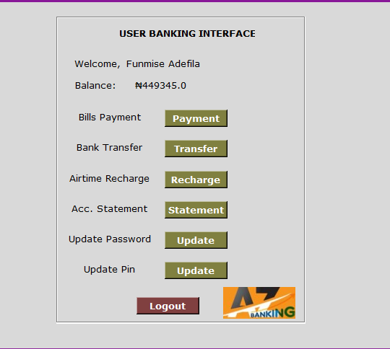
User Banking Interface
This page allows customers to make payments, perform transfers from their account numbers, recharge their phone numbers and check their statements of account.

Slide 15
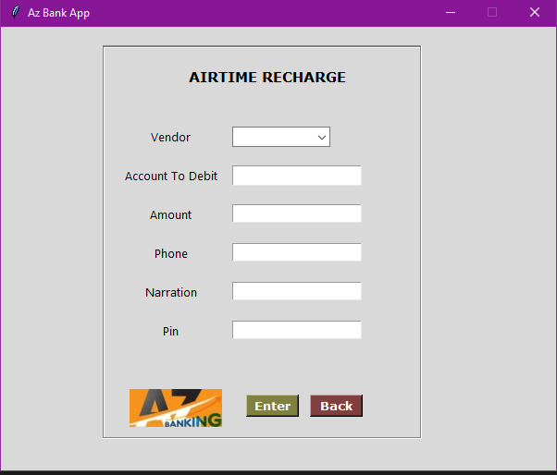
VTU Top Up
This page is for airtime top-up, it accepts inputs such as the below details from the customers:
Vendor
Account to debit
Amount
Phone
Narration
Pin

Slide 16
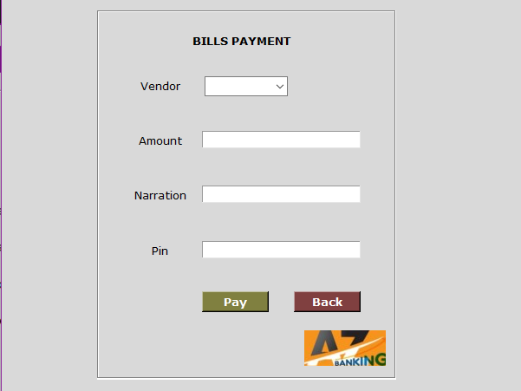
Bills Payment
Customers can pay their bills here, all that is required is just to pick the vendor, input amount, narration and pin.

Slide 17
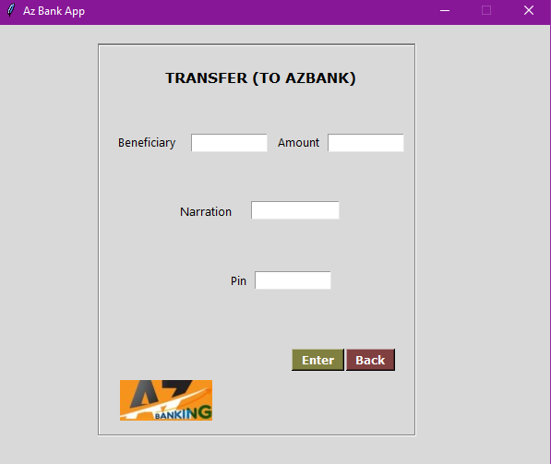
Bank Transfer
The customer can transfer from his account to another account with the following inputs:
Beneficiary
Amount
Narration
Pin

Slide 18
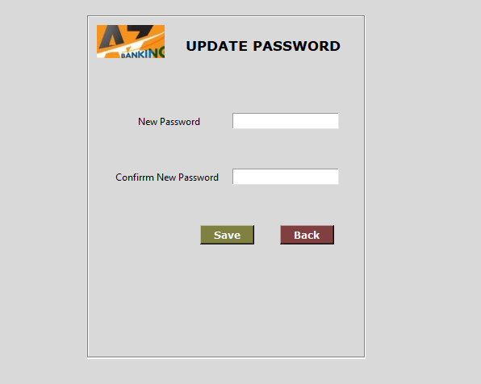
Update Password
Here, the customer can update his password in the database.

Slide 19
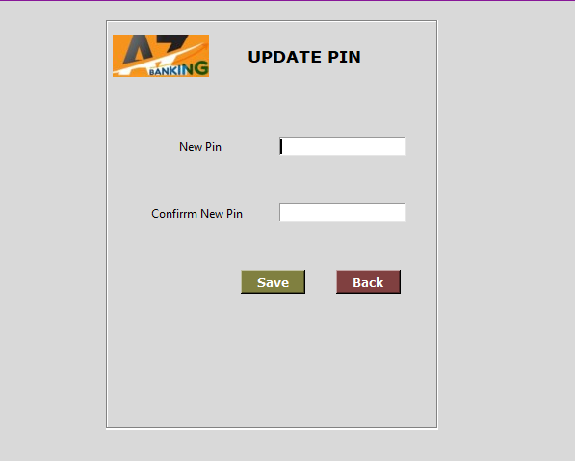
Update Pin
Here, the customer can update his pin in the database.

